Slide 1
The New Normal and Innovation in Publishing
Steven Ottogalli, Assoc. Editorial Director, Wiley
Wiley Research Seminar |March 9th and March 16th 2021

Slide 2

When we’re all focused on helping researchers share their best work with more people, everyone benefits

Slide 3
The New Normal
The same goal, in a changing world.
New economic realities driven by research funders and by the pandemic
Increased pressure on editors, peer reviewers and authors
Dependency on manual inputs and interventions

Slide 4

As pressures in the publishing ecosystem increase,
we’re accelerating our ability to solve for them

Slide 5
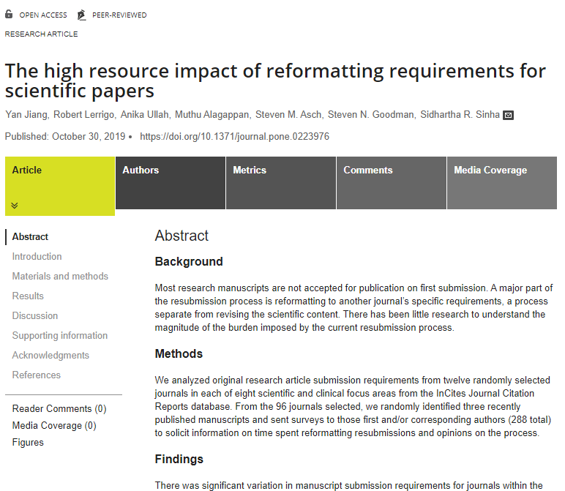
Free Format Submission
Flexibility to submit papers in the format that authors prefer.
Free format submission saves time for authors and builds journal reputation with an easy submission experience.
“time spent on reformatting delays most publications by at least two weeks and by over three months in about 20% of manuscripts.”
Source: https://journals.plos.org/plosone/article?id=10.1371/journal.pone.0223976

Slide 6

Research Exchange (ReX)
A smart, simple submission platform.
Powered by machine learning, ReX reads the author’s manuscript and auto-populates fields with key information for the author to verify.

Slide 7



Transfer Networks
Seamless resubmission alternatives for publishable papers, benefiting authors, reviewers, and the whole community.
Better Publishing Experience
More Efficient Peer Review
More Quality Submissions

Slide 8

Ensuring integrity and quality while getting time back in the publication process.

Slide 9
Expert Guidance and Support
Experts to guide all aspects of the review process.
Data-backed guidance on improving speed and the author experience
Detailed, tailored reporting on journal and performance metrics
Onboarding and training assistance for incoming editors
Publication ethics guidance
Best practices to improve editorial processes, referring manuscripts, and transparency in peer review

Slide 10

Reliably publishing the highest quality content, using resilient processes and tools.

Slide 11



Unlocking the power of automation
Contemporary design
Right-fit copyediting
Lean workflows

Slide 12
Making publishing work better, for everyone.

Slide 13
Q&A
Steven Ottogalli
sottogalli@wiley.com

