Slide 1
What’s Next for Research Integrity?
Chris Graf, Director, Research Integrity, Wiley
Wiley Seminar, Japan, March 9, 2021
Notes:
What we mean by “research integrity” and the role editors and publishers have in shaping its future
Learn about current challenges from a publisher’s and journal’s perspective and how everyone involved in research can help to uphold research integrity.

Slide 2
Overview
Agenda
What do we mean by research integrity?
What issues do we see?
Case studies
How can we shape the future of research integrity?

Slide 3

Start a conversation about research integrity…
What do we mean by research integrity?
Poll
‘‘
… and many researchers will assume you’re talking about misconduct.
Nature 570, 5 (2019) doi: https://doi.org/10.1038/d41586-019-01727-0
Notes:
Is that true for you? Let’s do a poll!
Slide 3 (I’ll read the slide, and say “Is that true for you? Let’s do a poll…”)
When you start a conversation about research integrity what do you assume it will be about?
1. Misconduct investigations into possible fraud, fabrication, or plagiarism
2. Systems that boost the quality and reliability of research
3. Both of the above
4. Something different

Slide 4
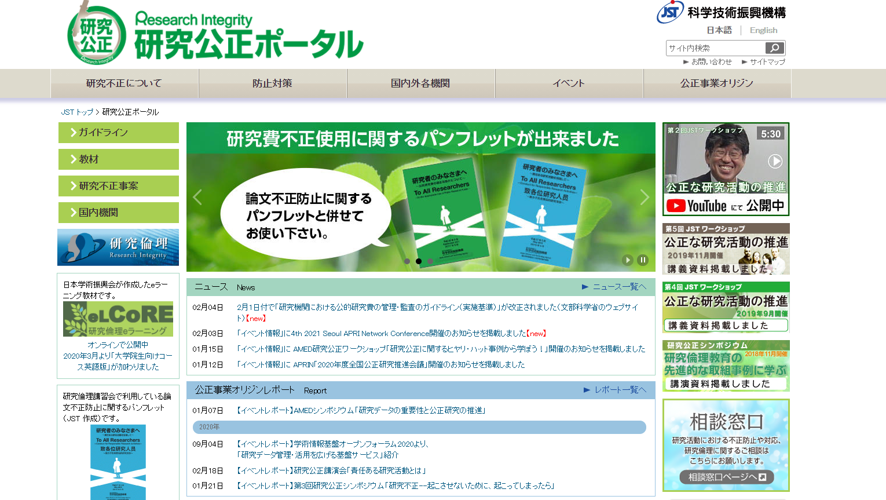
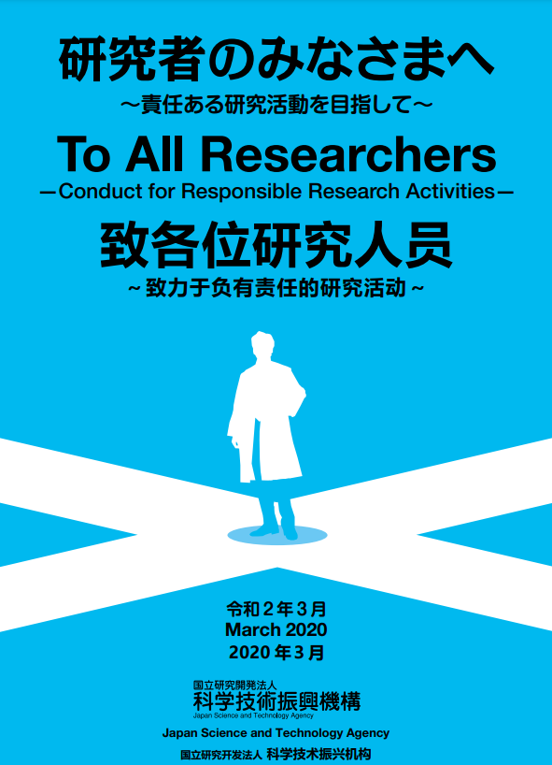
https://www.jst.go.jp/kousei_p/
Notes:
From Japan Science Technology Agency with Japan Agency for Medical Research and Development with Ministry of Education, Culture, Sports, Science and Technology Japan
JST’s Conduct for Responsible Research Activities covers both…
1. JST strictly condemns any misconduct in research activities.
2. JST believes that honesty in research activities is extremely important for Japan, which seeks to develop itself through science and technology.
3. JST supports honest and responsible research activities.
4. JST will promote education in research ethics and reform its research
If you didn’t already read the booklet, then do! There’s a link on this slide.
______________________
Code of Conduct for Scientists
Scientists shall recognize that they are responsible for assuring the quality of the specialized knowledge and skills that they themselves create
Scientists shall always make judgments and act with honesty and integrity, endeavoring to maintain and improve their own expertise, abilities, and skills
“Statement Code of Conduct for Scientists-Revised Version-” (2013) Science Council of Japan
Check Points for Prevention of Misconducts before Submitting Papers
□ Have you checked the ethical codes of the organization you belong to?
□ Have you checked the ethical codes and the authorship rules of academic societies you are affiliated with?
□ Have you checked the reproducibility of your research results before submitting papers?
□ Are your raw data, experimental specimen, and laboratory notebooks well stored and managed?
□ Has each of your coauthors confirmed his or her contribution and the shared responsibility in the publication?
□ Have you checked that your intended publication does not infringe upon duplication of publication as defined in the journal?
□ Have the expressions and contents in your submission paper cited other publications for avoidance of duplicate publications or plagiarism?

Slide 5

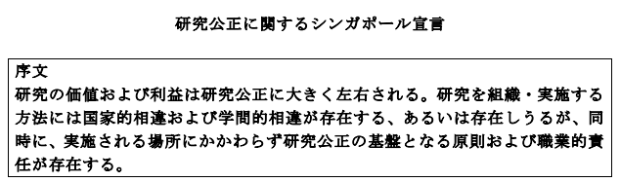
What do we mean by research integrity?
WCRI Singapore Statement
Honesty in all aspects of research
Accountability in research conduct
Professional courtesy and fairness
Good stewardship of research
https://wcrif.org/documents/310-ss-japanese/file
https://wcrif.org/guidance/singapore-statement
Notes:
Thinking beyond Japan, and internationally, we have Singapore Statement from WCRI, in 2010
“product of the collective effort and insights of the 340 individuals from 51 countries who participated in the 2nd World Conference on Research Integrity. These included researchers, funders, representatives of research institutions (universities and research institutes) and research publishers, and it was published in 2010”
Emphasis on Systems that boost the quality and reliability of research: lists 14 responsibilities, 12 describe affirmative steps; 2 related to “irresponsible research practices” (note: not only misconduct, but broader).
_________________
“The primary goal of research is to advance knowledge. For that knowledge to benefit research and society, it must be trustworthy – and the Singapore Statement encompasses that
https://wcrif.org/guidance/singapore-statement”
_____________
The Statement is the product of the collective effort and insights of the 340 individuals from 51 countries who participated in the 2nd World Conference on Research Integrity. These included researchers, funders, representatives of research institutions (universities and research institutes) and research publishers. The Statement was developed by a small drafting committee (listed below); discussed and commented upon before, during and after the 2nd World Conference; and then finalized for release and global use on 22 September 2010.
The primary goal of research is to advance knowledge. For that knowledge to be trustworthy. Trustworthy research is robust, rigorous and transparent at all stages of design, execution and reporting.
Conducting research with integrity, honesty and accuracy is something to which every scientist should proudly aspire. And research integrity is not a virtue that is either present or absent: it is a capacity that can be enhanced. It requires ongoing training for both early-career researchers and more senior faculty members, as well as the reworking of perverse incentives, and rewarding researchers for important but unglamorous contributions. Every conversation or course in research integrity is an opportunity to grow. Expectations, skills and standards must be constantly updated, especially as new fields such as metaresearch reveal more about the practices that strengthen science.
History bears this out. The idea of informed consent is less than 100 years old. In the Nature research journals, checks for blinding and randomization are just over six. Expectations that data and code will be fully open are becoming mainstream. These are all examples of improving research integrity. We should acknowledge them, and seek more.
https://www.nature.com/articles/d41586-019-01727-0

Slide 6
Problems are on a continuum: “Shades of grey”
Type of problem
Wrong observation
Wrong analysis
Inadequate record keeping
Withholding methods details
Double and sliced publications
Biased or post-hoc revision of study design
Ignoring previous work of others
Suppressing own data, dropping data-points
Undeclared conflicts of interest; Corruption
Undeserved authorship
Unfair review, wrong testimony
Espionage, giving away secrets
Misuse of public funds
Bullying, nepotism
Overlooking others' use of flawed data
Suppressing fraud allegation
No informed consent
Plagiarism 19. Falsification 20. Fabrication
21. Illegal human experiments
21
More serious
Less serious
Not intentional
Intentional
Adapted from Marcovitch et al. Croat Med J. 2010 Feb; 51(1): 7–15. doi: 10.3325/cmj.2010.51.7
Notes:
But of course, there are problems resulting from (WCRI terminology) “irresponsible research practices”
This figure is adapted from a paper by Marcovitch and colleagues from 2010, and illustrates the complexity that problems present
(describe axes; continuum; shades of grey)
#21 illegal human experiments is clearly a serious problem, and its almost certain that it would be intentional – so this would sit in the top RH corner
Other problems fit somewhere else. For example, #9 COI could sit anywhere on the continuum, depending on circumstances.
“there is a continuum from honest error to outright fraud -- what matters is intention, a quality which may be impenetrable to the observer”
__________________
While we all recognise research is fundamental to advancing knowledge and understanding. Nevertheless, error, questionable research practices and outright fraud can arise, as illustrated in this figure.
Illustrates spectrum of issues that can occur from non-intentional QRP (wrong observations, poor record keeping, poor study design) to intentional misconduct… plagiarism – using others work/ideas without credit to outright fraud – i.e. fabrication - making up results, falsification – manipulating results
But determining whether non-intentional vs intentional is difficult
https://www.ncbi.nlm.nih.gov/pmc/articles/PMC2829174/pdf/CroatMedJ_51_0007.pdf
Falsification = manipulating findings
Fabrication = making up results
Drivers? Lack of awareness/understanding or pressure to publish, self-promotion, financial gain.
“the simple presence of COI []for example] does not imply fraud or even any misconduct at all. COI of some sort, especially non-financial, may be inevitable, so not necessarily culpable. Nylenna and Simonsen postulated that there is no distinct line between ethical and unethical behavior; rather there is a continuum from honest error to outright fraud and what matters is intention, a quality which may be impenetrable to the observer (25). Nylenna has updated and amplified an illustration from that paper which is shown as the Figure 2.

Slide 7
What issues do we see?
COPE Cases Taxonomy
Authorship
Conflict of Interest
Consent for publication
Contributorship
Copyright
Correction of the literature
Data
Editorial Independence
Funding
Metrics
Questionable behavior
Mistakes
Peer review
Plagiarism
Questionable research
Redundant/Duplicate publication
Whistleblowers
The COPE (Committee on Publication Ethics) Case Taxonomy https://publicationethics.org/cope-case-taxonomy
Doing What's Right: Trust and Accountability in Peer Review
https://www.wiley.com/network/researchers/topical-food-for-thought/doing-whats-right-trust-and-accountability-in-peer-review
Notes:
So this is how COPE, Committee on Publication Ethics, thinks about and organises data on the cases publishers and editors like us see – in a formal taxonomy.
What is COPE? COPE = Committee on Publication Ethics -- provide supports for editors, publishers and those involved in publishing ethics with the aim of moving the culture of publishing towards one where ethical practices becomes the norm. All Wiley editors and journals have membership.
These are the main classification categories (17) COPE uses.
If a COPE member, like all of us, has a particularly complex case, can bring it to COPE for discussion. Cases categorised according to these terms.
At Wiley we see majority of issues in the bold categories: Authorship, Corrections, Data, Questionable behaviour, Plagiarism
We also see that problems are becoming increasingly complex… →

Slide 8
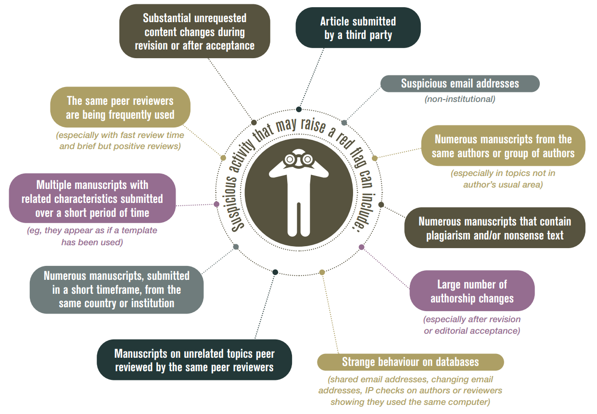
Issues are increasingly complex
Infographic from COPE guidance on Systematic Manipulation of the publication process https://publicationethics.org/resources/flowcharts/systematic-manipulation-publication-process
Papermills https://www.wiley.com/network/researchers/topical-food-for-thought/putting-a-stop-to-the-papermills-a-progress-report
Notes:
We see systematic manipulations at scale.
Systematic manipulation of the publication process is where an individual or a group of individuals have repeatedly used dishonest practices to manipulate the publishing process in some way.
Often occurs at scale across multiple manuscripts and multiple journals.
Authorship manipulation – inappropriate attribution of authorship of a piece of scholarly work; adding authors at revisions
Peer review manipulation - inappropriately influencing the independent assessment of the research – false identities or false emails
Image manipulation - publish fabricated or plagiarised research.
Papermills
_____________
Drivers? Publish or perish, financial motivations. Clear role for policy, technology, editorial standards.

Slide 9
Case studies
Notes:
So we’ve covered the first two sections on our agenda…
1. What do we mean by research integrity?
2. What issues do we see?
Let’s look at case studies of the kinds of things we see as editors and publishers, to make some of that more concrete
Journals don’t investigate or make findings of misconduct (universities or regulators do that)
Journals ensure what they publish is correct and that it conforms to expected legal and ethical standards
That’s what these cases show

Slide 10
Poll
Case study
What constitutes authorship?
A peer reviewer agreed to review a manuscript
They demand authorship because they had provided materials for the research
Should they be an author?
Considerations
Authorship criteria: Substantial contribution and accountability for the research
Is acknowledgement rather than authorship more appropriate?
Reviewer should have also declared COI
COPE Digest Authorship: May 2020
https://publicationethics.org/cope-newsletter/2020/may/cope-digest-authorship-may-2020-volume-8-issue-5
Notes:
Authorship is complex – all sorts of cultural and subject differences come into play
Read the question
Slide 10 (after I describe the case, before I click to show the considerations in the lower half of the slide)
Does the case on this slide have an obvious solution?
1. It’s black and white, with an obvious solution
2. It’s grey, and requires consideration and judgement
Review poll results, Discuss considerations…
ICMJE guidelines try to bring some clarity here, and are used widely (concept/execution, writing, approval, accountability)
Have seen cases where individual signed an Materials Transfer Agreement that stipulated authorship if used.
In majority of cases, authorship disputes mean journal puts manuscript on hold until resolved, usually by involving institution

Slide 11
Poll
Case study
What constitutes plagiarism?
Reader alerts journal to apparent plagiarism in a published article
The reader calls for retraction: What should the journal do?
Considerations
Where in the text do the similarities occur?
Direct copying and theft? Or use of prior published article as ‘inspiration’?
Is the data authentic? Are the results new?
If yes, a correction could be appropriate citing the previous publication
If no, a retraction could be appropriate
Related COPE Case https://publicationethics.org/news/case-discussion-suspected-plagiarism
Notes:
Read the question
Slide 11 (after I describe the case, before I click to show the considerations in the lower half of the slide)
Does the case on this slide have an obvious solution?
1. It’s black and white, with an obvious solution
2. It’s grey, and requires consideration and judgement
Review poll results, Discuss considerations…
Note retraction not used to punish. And journals don’t find misconduct – they ensure what they publish is correct and conforms to expected legal and ethical standards

Slide 12
Poll
Case study
What constitutes data fabrication?
Peer reviewer suspects data manipulation in a submitted manuscript
What could the editor and publisher do?
Considerations
Request time-stamped original data files
Raise with author’s institution to investigate
If satisfactory explanation, peer review can proceed
If unsatisfactory explanation, manuscript will be rejected
Related case discussion: https://publicationethics.org/news/case-discussion-data-fabrication-rejected-manuscript
Notes:
Read the question
fabricated (made up) or falsified (altered or partially deleted)
Slide 12 (after I describe the case, before I click to show the considerations in the lower half of the slide)
Does the case on this slide have an obvious solution?
1. It’s black and white, with an obvious solution
2. It’s grey, and requires consideration and judgement
Review poll results, Discuss considerations…

Slide 13
Solutions
How we can shape the future of research integrity
Notes:
We’ve done ... What do we mean by research integrity? What issues do we see? Case studies
Now let’s think about How can we shape the future of research integrity?
5 areas: Systems, global/local, policy/process, training, and open science/open research

Slide 14
‘‘
Researchers
Editors and publishers
Institutions
Funders
Solutions: We all have a role
It is about creating systems that boost the quality, relevance and reliability of all research
Research integrity is much more than misconduct
https://www.nature.com/articles/d41586-019-01727-0
Notes:
This has long been recognised and often quoted: Integrity is a shared responsibility, and we all have a role; No one stakeholder can do it alone
You’ll remember the first poll… where you shared your reactions to the quote “Start a conversation about research integrity and many researchers will assume you’re talking about misconduct. Too often, they are wrong.”
This quote is from the same article, in nature. [Read the quote]
“Research misconduct encompasses fraud, fabrication and plagiarism. It is essential to deal with such dishonesty thoroughly and fairly, but it’s patching up a tear after the damage is done. Research integrity includes such investigations, but it is much more. It is about creating systems that boost the quality, relevance and reliability of all research.”

Slide 15
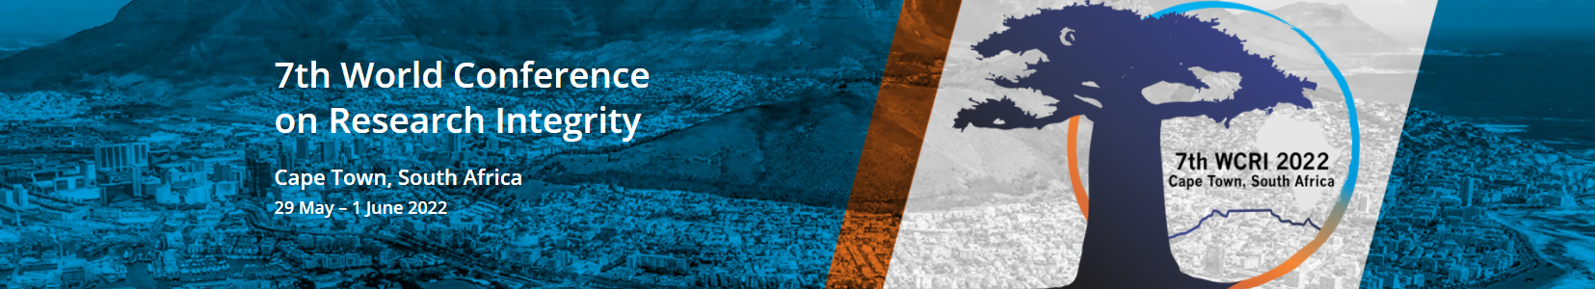

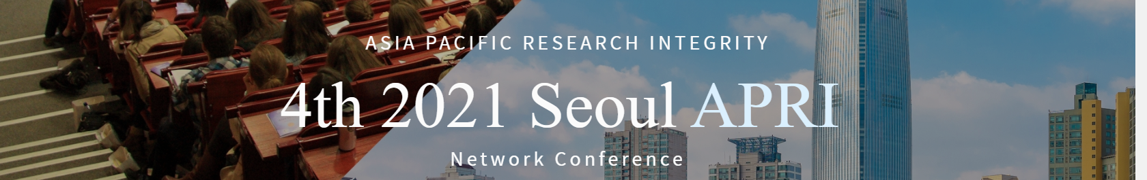
Foster best practice via local networks
Think global and act local
https://wcri2022.org/digital-event-2021/ https://wcri2022.org/ http://www.2021seoulapri.org/
Notes:
When it comes to good practice in science, we need to think global but act local (e.g., APRI, WCRI, JST, Singapore Statement, COPE)
On this slide:
WCRI 2022 Fostering Research Integrity in an Unequal World’. Important RI stakeholders include researchers, institutional leaders, national and international policy makers, funders and journals. All disciplinary fields from the basic and applied natural and biomedical sciences to the humanities and social sciences.
APRI Goals : Reinforcing the network for establishing research ethics in Asia-Pacific countries. Also, to exchange information and efforts to further put in place research ethics in each country and set a culture of Responsible Conduct of Research (RCR) that meets a global standard.

Slide 16
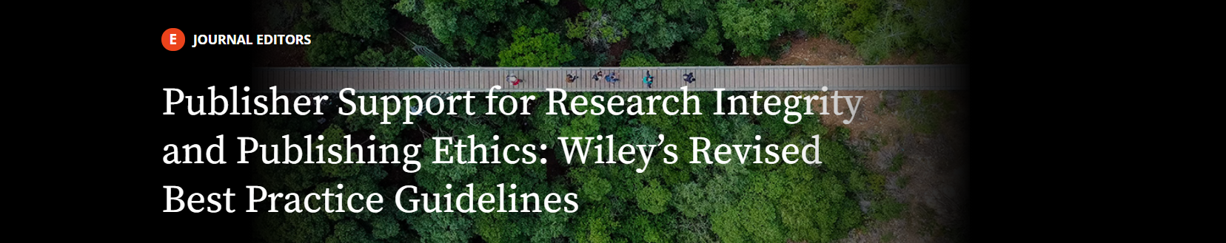
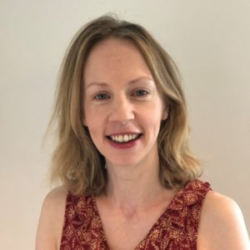
Editors and publishers have a duty of care
Establish clear policy and process
Wiley Support for Research Integrity https://www.wiley.com/network/journaleditors/peerreview-and-editorial-office-management/publisher-support-for-research-integrity-and-publishing-ethics-wiley-s-revised-best-practice-guidelines
https://authorservices.wiley.com/ethics-guidelines/index.html
Elizabeth Moylan, Publisher in the Research Integrity team at Wiley
Notes:
Acting local means act where we have most immediate impact, on our own policies and processes.
We have 2 centuries of publishing history at Wiley – and long-term thinking, commitment to quality. But is that unvoiced commitment enough?
No, it’s not. New challenges (papermills) require constant attention, require clear policies (which may be relatively stable) and processes (which need review and work)
Our goal editorially should be to help authors to deliver as much as is possible a complete and rigorous account of “what happened” so that readers can trust what they read.
We’re the only people who oversee and maintain integrity of published literature - so if issues come up after publication, we address them and transparently amend the article

Slide 17
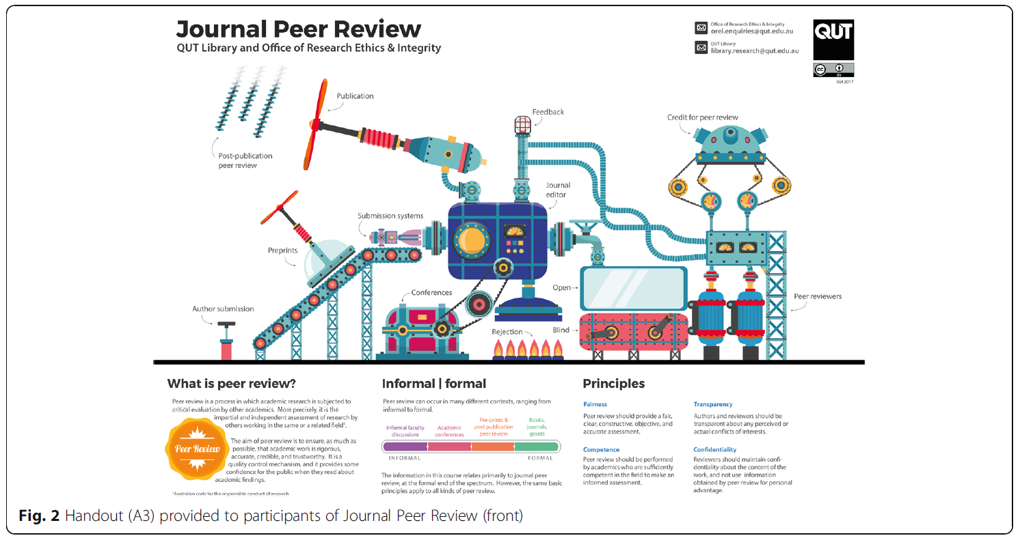
Support collaborative training
Infographic from: Designing integrated research integrity training: authorship, publication and peer review
https://researchintegrityjournal.biomedcentral.com/articles/10.1186/s41073-018-0046-2
Also:
Wiley open research workshops: what did we learn?
https://www.ukrn.org/2020/12/01/wiley-open-research-workshops-what-did-we-learn/
Notes:
Collab training – reaching out with our knowledge and expertise.
Here’s QUT Library in Collab with QUT Office for Research Ethics and Integrity – a collab, bridging silos
In 2020 Wiley in the UK did the same – with libraries, integrity teams, and the UK Repro Network – breaking barriers and silos
_______________________
Queensland University of Technology (QUT), developing training courses about research integrity practices in authorship, publication, and Journal Peer Review.
the development of integrated research integrity courses to complement the more specific research integrity training that is the topic of a compulsory online course. Our new courses are “integrated” in the sense that although they promote research integrity, they are not explicitly about research integrity.
Wiley… In our pursuit of new approaches that make research as reliable and trustworthy as it can be, we recently partnered with UKRN to host a series of open research workshops, over 6 months, across 9 UK universities, and involving over 250 researchers.
Workshops were bespoke depending on university and researcher needs. Latterly they were delivered virtually, and overall the audience response and participation exceeded all expectations. Topics on offer included: preprints, authorship, registered reports, data sharing, and open access.

Slide 18
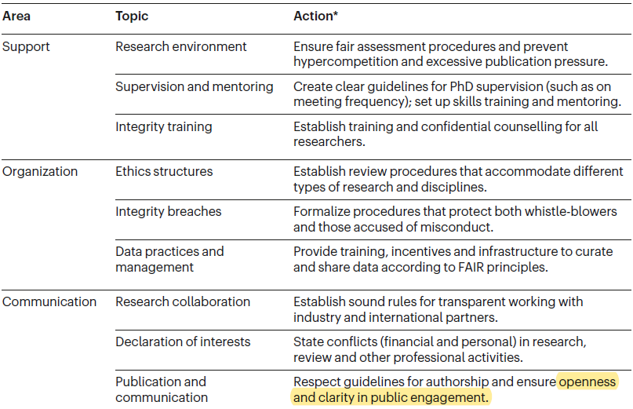
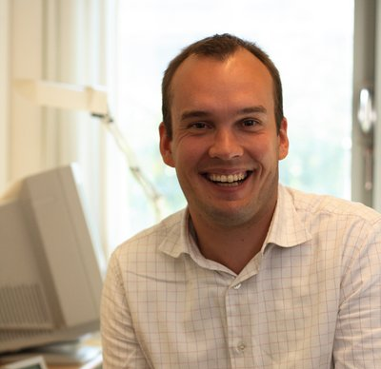
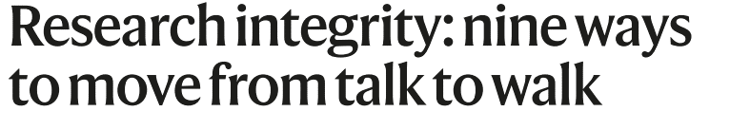

“Ensure openness and clarity in public engagement”
SOPs4RI
Niels Mejlgaard is professor of political science at Aarhus University, Denmark.
Nature 586, 358-360 (2020) https://doi.org/10.1038/d41586-020-02847-8
Notes:
Ensure openness.
Niels Mejlgaard is professor of political science at Aarhus University, Denmark. Lead author on initial report from SOPS4RI … Standard Operating Procedures for Research Integrity (SOPs4RI),
SOPs4RI will establish an inventory of relevant Standard Operating Procedures (SOPs) and Guidelines that RPOs and RFOs can draw on when developing governance arrangements promoting strong research integrity cultures
Found firm consensus on nine topics in the table
_______________
included 2 scoping reviews of the literature; 23 interviews with research-integrity experts across research institutions, funding organizations and committees; a Delphi study — an iterative, consensus-oriented study — involving a panel of 69 research-integrity policymakers; and 30 focus groups across European countries
The European Union’s next research-funding programme, Horizon Europe — which starts next year and runs until 2027 — will confirm a strong commitment to research integrity (see go.nature.com/2gvcxt3). It is expected that institutions receiving funding from the €81-billion (US$96-billion) programme will be required to have clear plans and procedures in place for research integrity³.

Slide 19
Open Access
Open Collaboration
Open Reward and Recognition
Open Data
Open Practices
SOPs4RI
“Ensure openness and clarity in public engagement”
Specifically: Open Research
Open research improves the accessibility, reproducibility, and integrity of research outputs
How can we encourage open research practices https://www.wiley.com/network/researchers/licensing-and-open-access/how-can-we-encourage-open-research-practices
Notes:
Specifically, when SOPs4RI talks about openness and clarity, let’s think about what we do as editors and publishers
Open research - openness and clarity within easy reach
Explain diagram
Helping researchers share their work with the world
Maximizing the value of research
Helping researchers work together
Transparency in research communication and peer review
Making sure researchers get credit for all their work

Slide 20
Open Access
Open Collaboration
Open Reward and Recognition
Open Data
Open Practices
SOPs4RI
“Ensure openness and clarity in public engagement”
Specifically: Open Research
Open research improves the accessibility, reproducibility, and integrity of research outputs
How can we encourage open research practices https://www.wiley.com/network/researchers/licensing-and-open-access/how-can-we-encourage-open-research-practices
Notes:
Wiley supports the open choices researchers want to make in: Open Access, with Preprints, and with Open Data
Let’s focus on those

Slide 21

I love preprints
Open Practices
‘‘
As a young researcher, I find these draft versions of potential journal articles invaluable
Elijah Lowenstein is a PhD candidate in biology at the Max Delbrück Center for Molecular Medicine in Berlin where he works on sensory neuron diversity @Lowensteined
https://blogs.scientificamerican.com/observations/i-love-preprints/
Notes:
What’s preprint? This is Elijah Lowenstein, a biologist in Berlin. He says in Scientific American, that he loves preprints.
He also explains that a preprint is a draft version of a potential journal article. For Elijah Lowenstein, preprints are awesome:
THEY SAVE TIME -- THEY BRING THE DISCUSSION ONLINE
THEY LET RESEARCHERS SHARE NEGATIVE RESULTS -- THEY FOSTER A MORE OPEN RESEARCH CULTURE
https://blogs.scientificamerican.com/observations/i-love-preprints/
__________________
THEY SAVE TIME
“The thing is, researchers in biomedical science wait an average of eight months after submitting their article to a journal for it to be published. Eight months is a very long time for a graduate student who wants to eventually, you know, graduate.”
THEY BRING THE DISCUSSION ONLINE
“Talking about my research with my labmates made me realize that science isn’t as straight forward as I thought it would be. They challenge my ideas and I challenge theirs.”
THEY LET RESEARCHERS SHARE NEGATIVE RESULTS
Once you start doing your own experiments, you realize that most of them don’t work. I wish more people would write about these failures”
THEY FOSTER A MORE OPEN RESEARCH CULTURE
I made my first contribution to this culture in October, 2017 with this preprint, which was finally published in a journal in February, 2018.

Slide 22
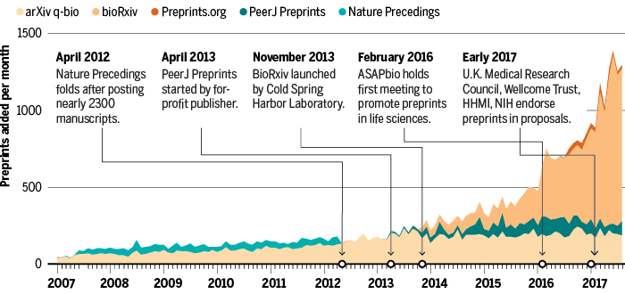
The new thing that’s been a long time in the making
Kaiser J. Are preprints the future of biology? A survival guide for scientists. 2017. Science. doi:10.1126/science.aaq0747
Notes:
Of course, preprints have been a tradition in some disciplines like physics, since the early 1990s
Other communities were slower -- gaining momentum in the life sciences until the launch of bioRxiv (https://www.biorxiv.org/) in 2013.
This graphic from Science ... timeline of preprinting in the life sciences…from a slow burn to now exponential growth
Astounding fact: Preprints are now growing many times faster than the number of journal articles published
Overall numbers are much mich smaller - preprints still only represent a small percentage of the articles published every year (~3% in biomedical/life sciences, for example),
but, while the numbers are small (for the moment), that was before publishers really started integrating preprints into their workflows AND before the unprecedented changes brought in by the COVID-19 pandemic…
Let’s look at that
things changed with COVID. Significantly.
The early, rapid dissemination that preprints provide came to the forefront during the COVID pandemic.
At a time when literally every day means more lives lost, the research world has moved faster than many would have suspected possible, producing an absolutely staggering level of research output.
Across a wide number of preprint servers, at periods in 2020 there were hundreds of COVID preprints posted PER DAY.
This tells us something about how fast research and research publishing are evolving…
…and it tells us something about how comfortable researchers are becoming with new open research practices where they find value.

Slide 23
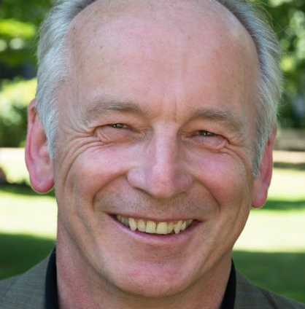
Pretty soon all science will be data science
Open Data
‘‘
Jean-Claude Burgelman at the United Nations Open Science Conference, November 2019
https://research.un.org/c.php?g=961229&p=6989510
https://www.fosteropenscience.eu/resources
Notes:
This is Jean-Claude Burgelman. He leads open science and data policy at the EC’s Directorate-General for Research and Innovation
Burgelman said “Pretty soon all science will be data science” at the open science conference held at the UN late last year.
One of the reasons is that funders, like the one Burgelman worked for at the time, are putting requirements for data sharing into their policies.
European Commission: Horizon Europe, the EUR100billion funding programme from the European Commission, which will challenge funded researchers to deliver:
"open access to publications, data, and to research data management plans" starting in 2021
This extends the open access policy of Horizon 2020, the previous funding framework, to more than journal articles.
Research funding frameworks like Horizon Europe (2021 to 2027), and others around the world, are becoming quite insistent that require that researchers share data
___________________
https://ec.europa.eu/commission/sites/beta-political/files/budget-may2018-research-innovation_en.pdf

Slide 24

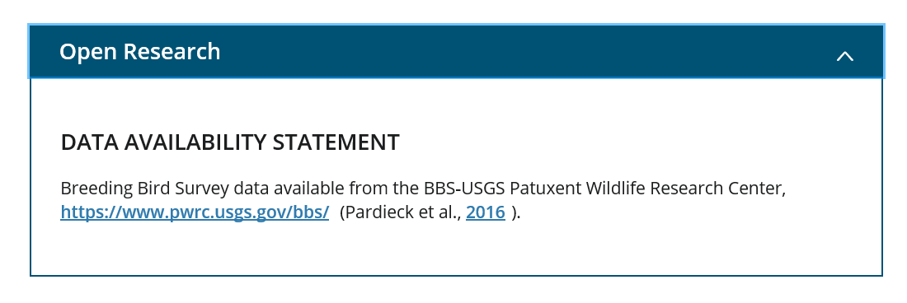
Open data at Wiley
Journals increasingly ask researchers for a “Data Availability Statement”
https://authorservices.wiley.com/author-resources/Journal-Authors/open-access/data-sharing-citation/data-sharing-policy.html

Slide 25
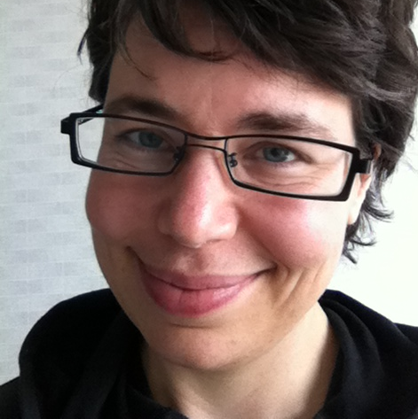
Papers freely available obtain 18% more citations…
Open Access
‘‘
... accounting for both age and discipline
From analysis of three samples of 100,000 journal articles
Heather Piwowar is a researcher in research data availability and reuse, and cofounder of Impactstory, @researchremix
https://www.ncbi.nlm.nih.gov/pmc/articles/PMC5815332/
Notes:
This is Heather Piwowar, a researcher and open access advocate – she has a bachelor’s and master’s degree from MIT in electrical engineering, 10 years of experience as a software engineer, and a Ph.D. in Biomedical Informatics.
Heather and colleagues, in their study “The state of OA: a large-scale analysis of the prevalence and impact of Open Access articles” helps us understand how much of the literature is OA?
They looked at three samples, each of 100,000 articles, and found 27.9% are open access (95% CI [27.6–28.2] – and that’s 27.9% of all DOI-assigned journal articles, using the Crossref-DOI)
Other estimates – like publishing industry market reports from Simba – agree that, by one method or another…
***About 30% of everything that researchers are publishing, now globally, they are publishing OA.***
So what’s the impact of that for researchers? →
From the same study, what is the scholarly impact of open access, measured in citations?
Papers freely available obtain, on average, 18% more citations than expected (accounting for age and discipline)
Another estimate, from the publisher Springer Nature, suggests on average OA articles are cited up to 60% more frequently, or 1.6 times, than similar subscription articles
https://media.springernature.com/full/springer-cms/rest/v1/content/16462702/data/v1
That’s more citations … and any lingering debate about this has turned into general acceptance that there is a real citation advantage associated with open access.

Slide 26
Publishers like Wiley support open access choices
OA at Wiley
So that authors can call on funds made available by their funders to pay article publication charges, or APCs
https://authorservices.wiley.com/open-research/open-access/index.html

Slide 27
In summary
Notes:
What do we mean by research integrity?
What issues do we see? Case studies
How can we shape the future of research integrity?
_______
Solutions: We all have a role
Think global and act local
Establish clear policy and process
Support collaborative training
“Ensure openness and clarity in public engagement”

Slide 28

Newer practices put greater openness and clarity, and enhanced integrity, within easy reach
SOPs4RI
Nature 586, 358-360 (2020) https://doi.org/10.1038/d41586-020-02847-8
Notes:
Preprints, open data, open access

Slide 29
Thank you
Chris Graf, Director, Research Integrity, Wiley
cgraf@wiley.com
@chrisgrafpub
Thanks to Elizabeth Moylan for work on this presentation
@latwec
Notes:
Thank you to colleagues in the integrity in publishing group for their thoughts on this presentation, and for my Wiley colleagues in hosting this event.

Slide 30
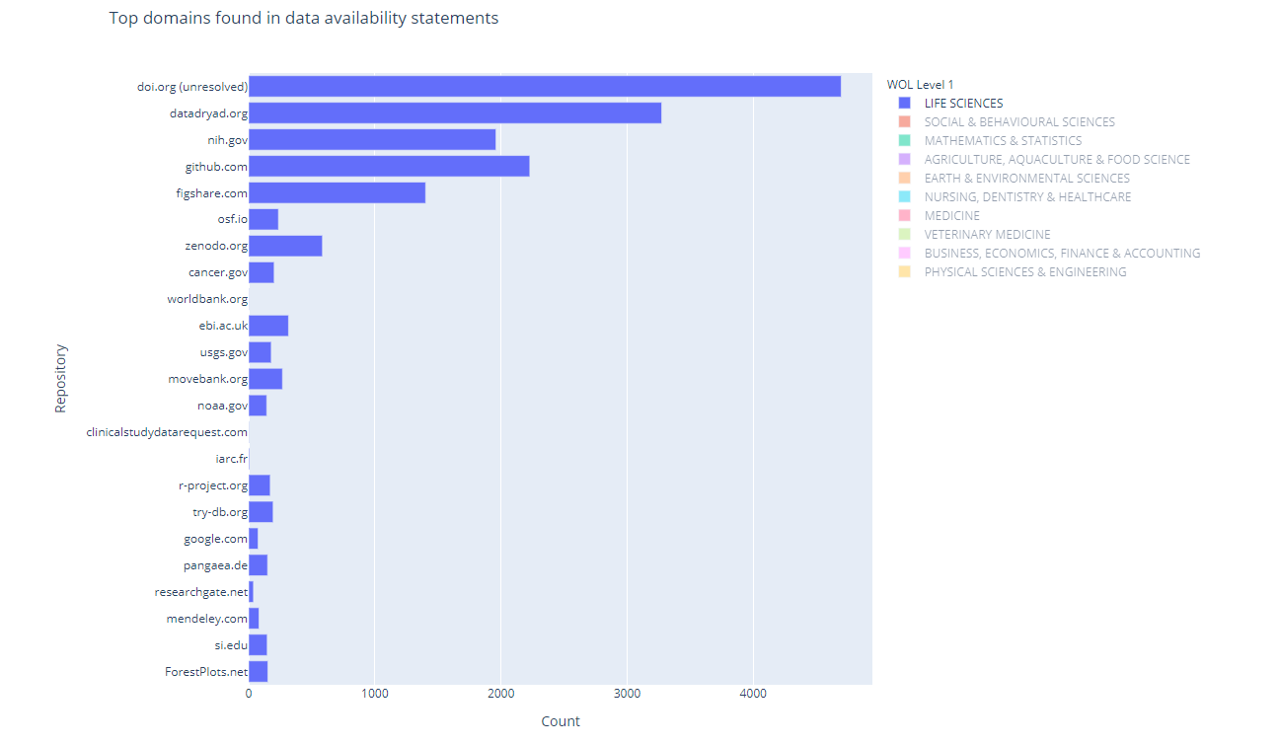
Tan et al. DOI: 10.22541/au.159422974.49069472

